Slide 1
Comm 2302
5-1-2020

Slide 2
News
Paper #2 questions
Pass/Fail extended to December
You can make up any of your blog posts up until 5/11 final
Have a safe summer!

Slide 3
Activity
Subgroups and subcultures
Describe a subgroup or subculture that you personally are a part of or that you see on media or social media.
Examples, fan of a certain game, what do they value, how would they describe themselves. Ex. CoD
On Social media, describe a group you might be a fan of, makeup tutorials for example, how would they describe themselves
On TV, what is a show you watch, how is the main family portrayed, how would they describe themselves. Ex. Bob’s Burgers

Slide 4
Why the Coronavirus Is So Confusing
Coronavirus many strains, mutating slowly
Research, so many studies, not yet peer reviewed
Experts, narrow field, not great at explaining complex issues
News reports focus on latest updates, not how science works
Conflicting messages from CDC, WHO, National, State, Local
Under reporting numbers, models ranges closing up
Hero’s Journey Narrative

Slide 5
What is a world view?
What is real? What is truth? How do we examine what is real? What do those methods look like?
If you know someone’s world view you can predict how they would react to different scenarios. What they think is real or the problem. How to examine the problem. What methods to use.
For COVID, how academics look at or study the problem, vs politicians, religious, business leaders.

Slide 6
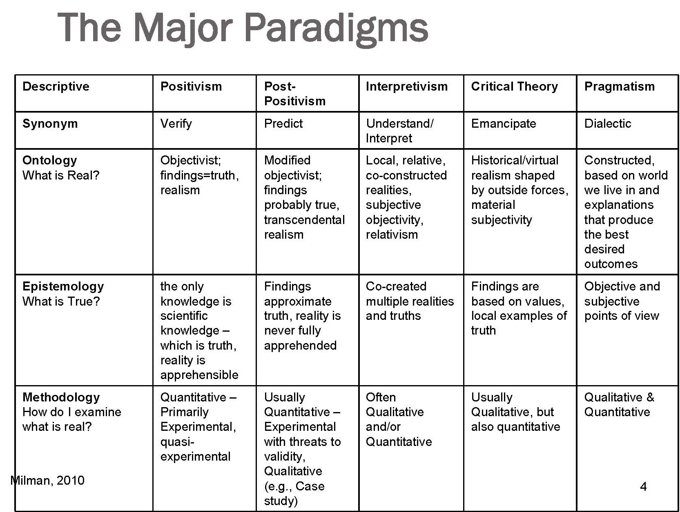
Post Modern
Deconstruction
Nothing is real only context of symbols. Semantics
Nothing exists outside of the text
Question presuppositions, values, ideologies,

Slide 7
Post Modernism
In premodern societies, social constructions of reality took form slowly and invisibly, and the symbolic universes that people wove about themselves seemed to be permanent fixtures of life.
Ex. Prehistoric Iceland
In modern societies- born out of social and physical mobility, with people beginning to suspect that there were different possible realities- individuals and groups gained, or tried to gain, more options. Ex. We need to define thing, have store signs, language
The postmodern individual is continually reminded that different peoples have entirely different concepts of what the world is like.
Ex. Extreme empathy, we don’t think of the world the same at all.

Slide 8
Social Construction of Reality
Socrates will attempt to persuade first the rulers and the soldiers that the rearing and education we gave them were like dreams
They only thought they were undergoing all that was happening to them, while, in truth, at that time they were under the earth within, being fashioned and reared themselves.
When the job had been finished, then the earth, which is their mother, sent them up.
The land they are in were a mother and nurse, they must plan for and defend it, if anyone attacks, and they must think of the other citizens as brothers.

Slide 9
Conflicts over values
What does your town or school value?
Small rural communities would not care about a lecture on epistemology (theory of knowledge) vs a graduate course in the Education department would have personal epistemological statements.
COVID so many different areas of expertise. Logistics impact Amazon, Grocery stores, businesses. Public health impacts hospitals, testing, also businesses. Technology impacts schools, shopping, boredom. Media information impacts science funding, public understanding.
I personally value longer in-depth magazine style pieces

Slide 10
Different groups have different values
Soldiers: Steady unskilled labor, tradition, violence
Right wing protestors: 2nd amendment, freedom, conservatism
CoD fans: guns, entertainment, friends, competition
All value patriotism, some value personal freedom more, some value their personal safety less, some value their own entertainment the most. Gun Ownership, Media representation, SES
From far away these groups can look similar, up close they are from different age groups, education backgrounds, urban/rural.

Slide 11
Blog Posts
Anouska
Blair
Sophia
Gail

Slide 12
Activity
Subgroups and subcultures, Find 3 things they value
Describe a subgroup or subculture that you personally are a part of or that you see on media or social media.
Examples, fan of a certain game, what do they value, how would they describe themselves. Ex. CoD
On Social media, describe a group you might be a fan of, makeup tutorials for example, how would they describe themselves
On TV, what is a show you watch, how is the main family portrayed, how would they describe themselves. Ex. Bob’s Burgers: mental health, relationships, struggling small business

