Slide 1
Comm 2302
4-29-2020

Slide 2
News and COVID Corner
Any survey questions?
https://a16z.com/2020/04/18/its-time-to-build/
Contact Tracing technology
https://twitter.com/Dylangonzalez21/status/1254894557575118849
Onion headlines
https://sports.theonion.com/tim-duncan-maps-out-spurs-genealogy-after-being-hired-1836669774

Slide 3
Activity
What is an example in any media you’ve ever seen of reality vs a simulation of reality?
What is the question the writers are trying to answer or prove?
What is the twist in that new world?
Ex. Matrix, Westworld
What we think isn’t real? Life is a simulation? This virtual world is fun or dangerous? Virtual crime is sexy? Life is planned by AI

Slide 4
The Precession of Simulacra
Disneyland is an imaginary idea of of the “real” America.
Made for children to act like children
Hyper-simulation of rides, fun, positive affect
Adults go to Disneyland to be childish, when childishness is everywhere, particularly in those adults outside of Disneyworld
Illusion is no longer possible
Impossible to stage a simulation of a robbery, all the signs that are there, make everyone see a REAL robbery

Slide 5
Relation to current events
RE: Andressen piece, Institutions are difficult to change, the conditions that brought them to be, equilibrium, static, hard to change anything quickly, erode the edges, play the game with old rules, slow to adapt, do you want to be the first to go back and eat in a restaurant?
Danger of minorities wearing masks, in media they are robbers, will be shot and killed by police.
Animal crossing, make your own schedule, there are points for doing some activities, or you can make your own schedule, explore where you want, decorate your house, all these ideas are old
Regression to more comfortable times, lack of danger, uncertainty

Slide 6
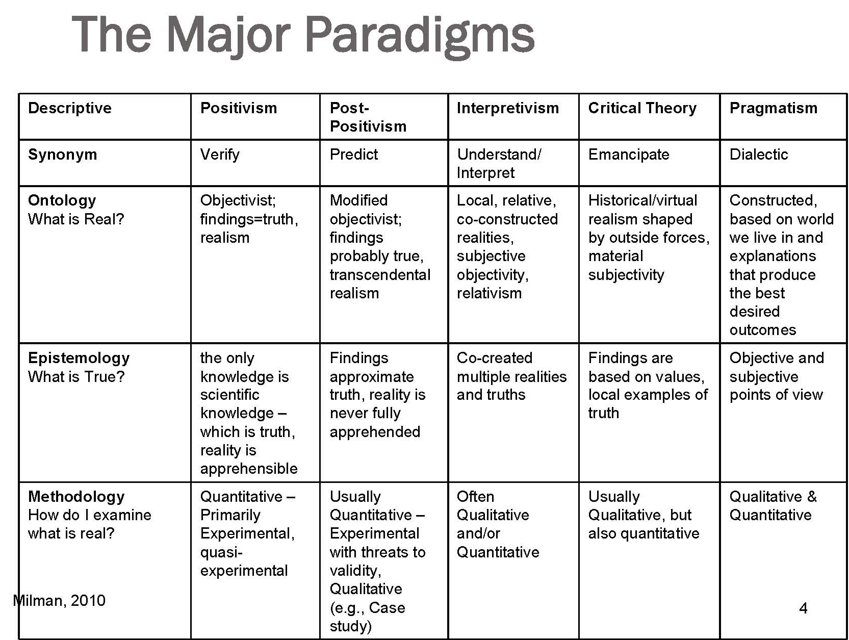
Post Modern
Deconstruction
Nothing is real only context of symbols. Semantics
Nothing exists outside of the text
Question presuppositions, values, ideologies,

Slide 7
Post Modern (paradigm)
Postmodernism is typically defined by an attitude of skepticism or distrust toward grand narratives, ideologies, and various tenets of Enlightenment rationality, including the existence of objective reality and absolute truth, as well as notions of rationality, human nature, and progress.
Even the Joker’s belief in chaos and upending the established order is an ideology itself. He really did have a plan, crime, had a point to prove. Yin to Yang. Post Modernism, no story, no cause effect.
Context of symbols, what does this mean now? Gun, hand painting on walls, no thinking, just reacting. Objects have no fixed meaning.

Slide 8
Post Modernism
In premodern societies, social constructions of reality took form slowly and invisibly, and the symbolic universes that people wove about themselves seemed to be permanent fixtures of life.
Ex. Prehistoric Iceland
In modern societies- born out of social and physical mobility, with people beginning to suspect that there were different possible realities- individuals and groups gained, or tried to gain, more options. Ex. We need to define thing, have store signs, language
The postmodern individual is continually reminded that different peoples have entirely different concepts of what the world is like.
Ex. Extreme empathy, we don’t think of the world the same at all.

Slide 9
More examples
Augmented reality training, making you relive trauma, sharks
Putting you in a situation that would be dangerous, difficult to set up, or expensive for some training.
Example in Inception, training for soldiers to kill each other but safe
Often in these virtual scenarios, you also lose your “outside” or “past” memory. It’s dramatic to be put into a whole new world.
Otherwise you know you’re playing a game.

Slide 10
Blog Posts
Andrea
Luke
Emma F
Jacy

Slide 11
Activity
What is an example in any media you’ve ever seen of reality vs a simulation of reality?
What is the question the writers are trying to answer or prove?
What is the twist in that new world?
Ex. Matrix, Westworld
What we think isn’t real? Life is a simulation? This virtual world is fun or dangerous? Virtual crime is sexy? Life is planned by AI

