Slide 1
Comm 2302
2/7/2020

Slide 2
Persuasive Print Ad
Details

Slide 3
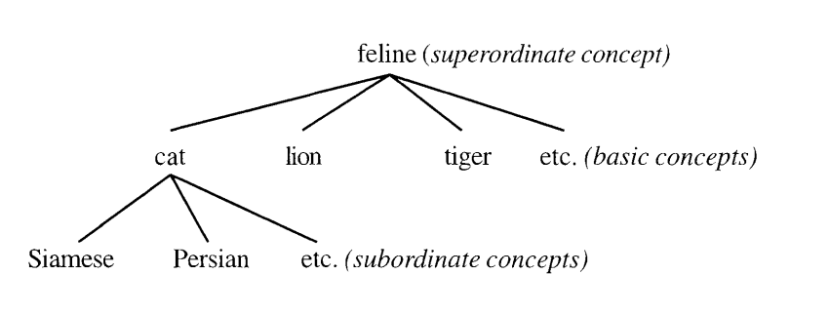
Messages, signs, and meanings
A sign is anything (a color, a gesture, a wink, an object, a mathematical equation, etc.) that stands for something other than itself.
Image itself is a concept (Image of a cat)

Slide 4
Cat examples
IG examples of cats
Cat memes, being cute, sleeping, having different personalities, getting into trouble, anthropomorphizing

Slide 5
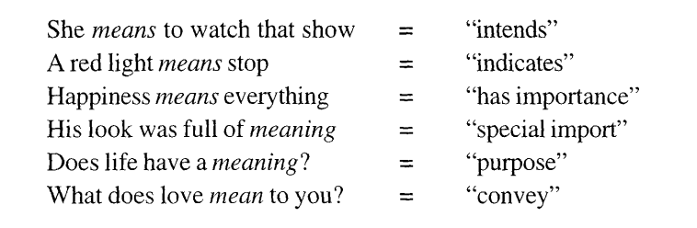
Meaning of Meaning

Slide 6
Connotation vs Denotation
Denotation
  House: a structure for human habitation
Connotation
  The house is in session = “legislative assembly”
  The house roared with laughter = “audience in a theater”
  They sleep at one of the houses = ”dormitory”
  at Harvard

Slide 7
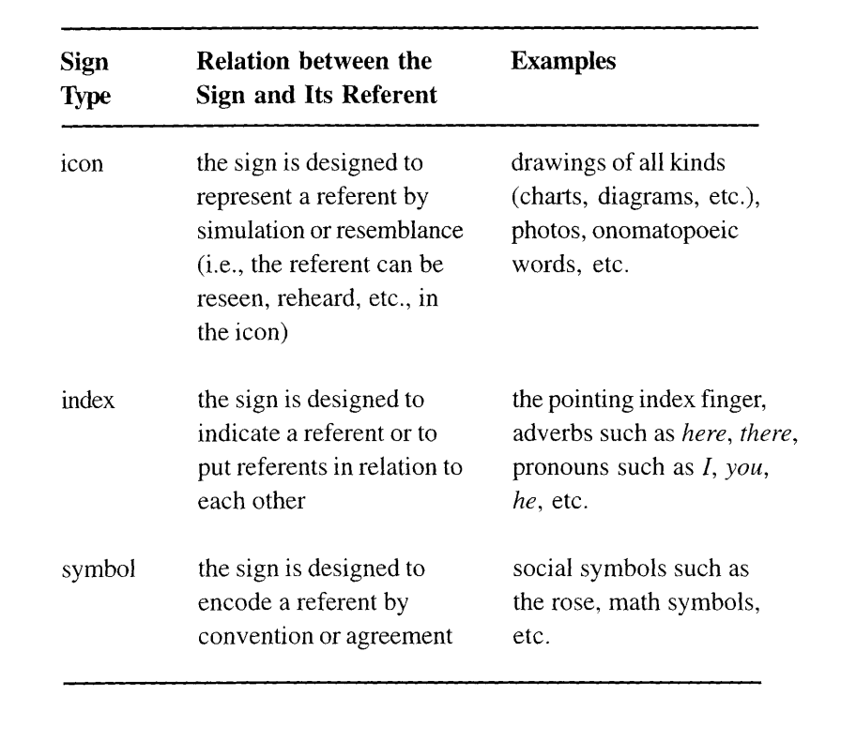

Slide 8
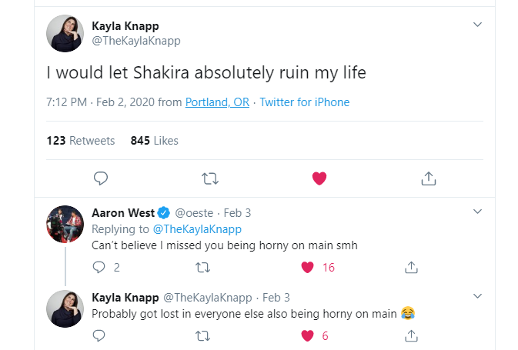

Slide 9
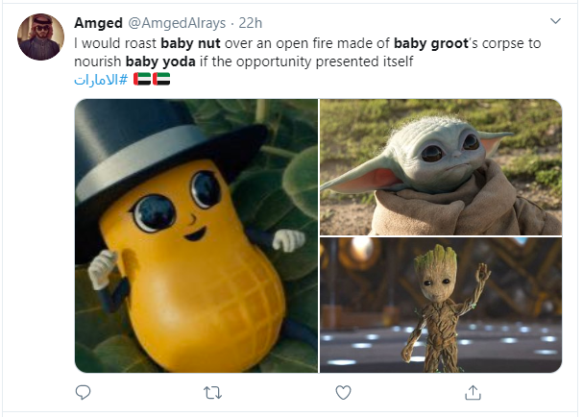

Slide 10
Activity
In pairs pick a meme, what is literal (denotation)? what is the specific meaning in this context (connotation)?
Example
“Let someone [Shakira] ruin my life” (Denotes decisions that end bad)
Being horny on main: Openly thirsting or sexually interested in someone in public, shared openly (Connotation)
Baby nut, Baby Yoda, Baby Groot, combining all three to make a joke, which one the author likes the best, extreme

