Slide 1
Comm 2302
2/5/2020

Slide 2
Type
Basic categories, Old Style, Sans Serif, Decorative, Slab Serif, Script
Different meanings
Line space (Space between lines)
Kerning (The space between letters) We vs W e
Readability: Make sure it cannot be read or said a different way than intended
Ads in general, can they be misinterpreted.

Slide 4
Picking colors
Picking two colors on opposite sides of color wheel
Picking a triad of three colors evenly spaced out
Colors next to each other would clash, pink, red, orange
Default of navy blazer with yellow or gold tie

Slide 5
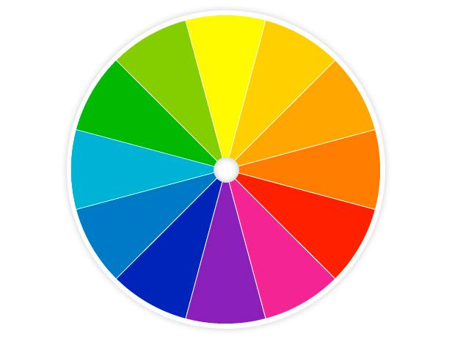
Color Wheel

Slide 6
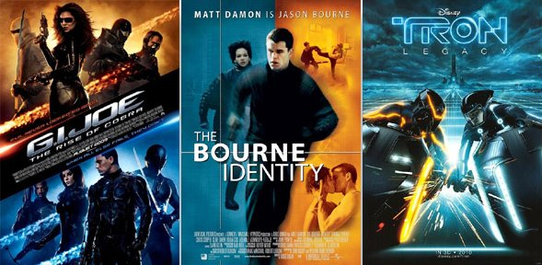

Slide 7
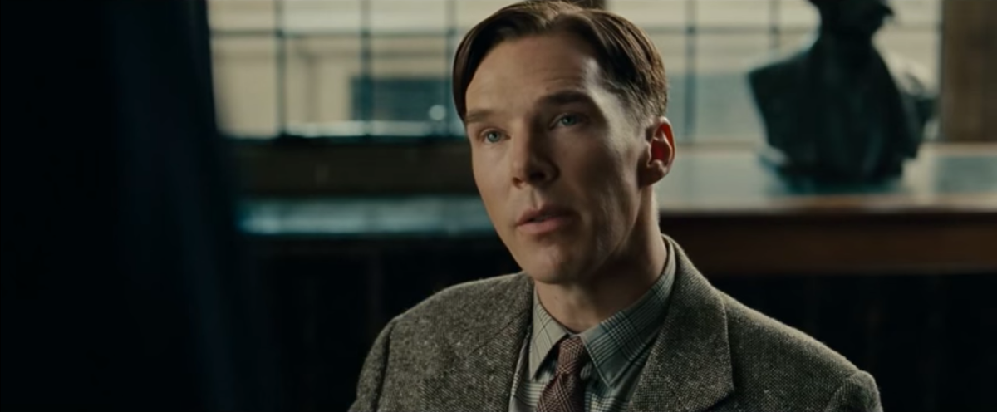
The Imitation Game

Slide 8
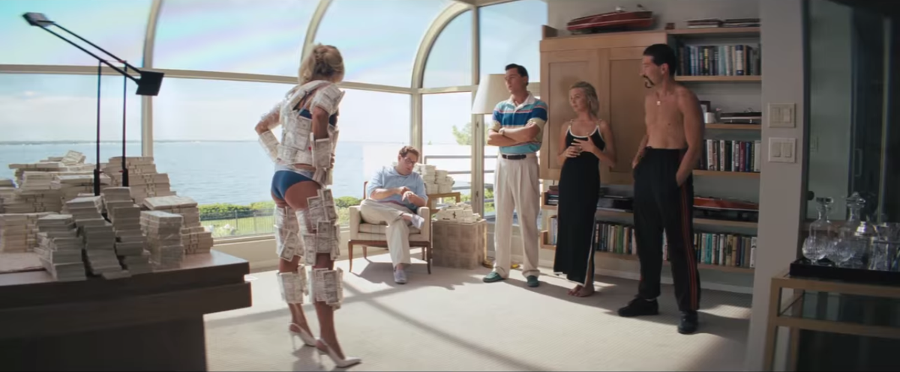
The Wolf of Wall Street

Slide 9
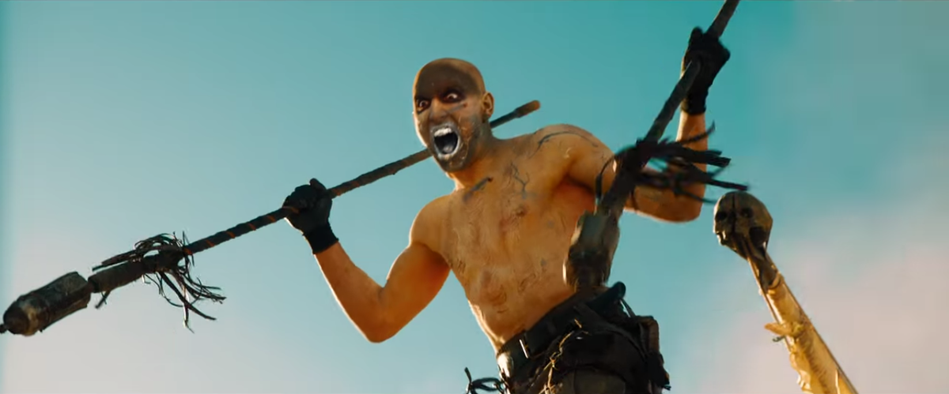
Mad Max

Slide 10
Blue and Orange Theory
Orange and Blue naturally contrast
Digital movies -> One color scheme -> Whole movie (Transformers)
We want the most contrast possible
Natural contrasting, sky and sun, water and fire, etc
Skin tone ranges fall in the orange spectrum
(Actors are roughly orange)
(Explosions are orange)

Slide 11
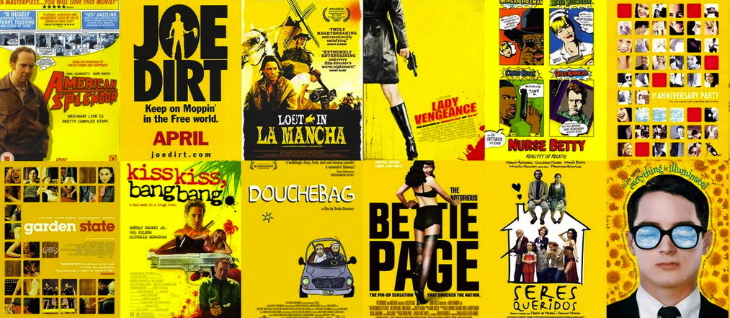
Indie movies, with award wreaths

Slide 12
Link to types of movie posters
https://www.boredpanda.com/movie-poster-cliches/?utm_source=google&utm_medium=organic&utm_campaign=organic

Slide 13
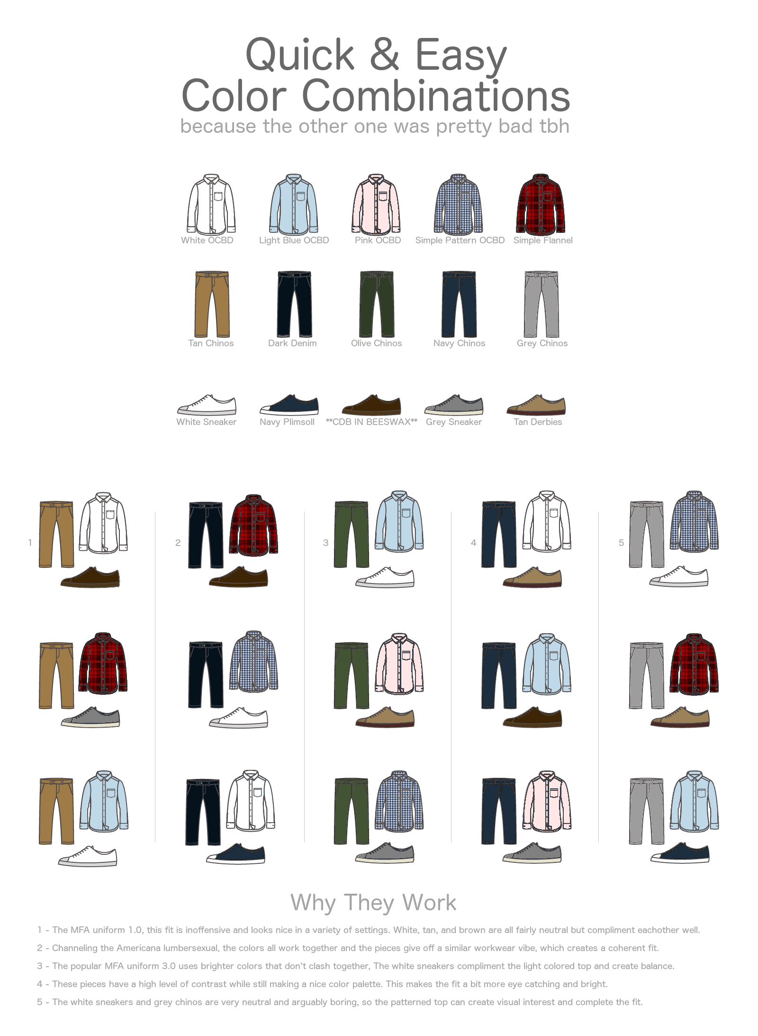

Slide 15
Blog Posts
We never talked about the super bowl on Monday

Slide 16
Activity
Document camera presentations of your ad drafts
Common feedback for print ads

