Slide 1
Comm 2302
2-21-2020

Slide 2
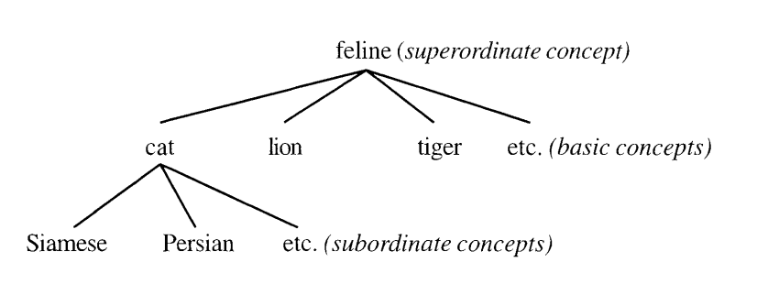
Messages, signs, and meanings
A sign is anything (a color, a gesture, a wink, an object, a mathematical equation, etc.) that stands for something other than itself.
Image itself is a concept (Image of a cat)

Slide 3
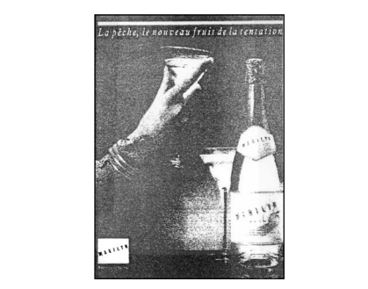

Slide 4
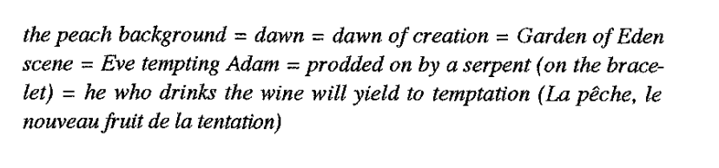
Connotative chain

Slide 5
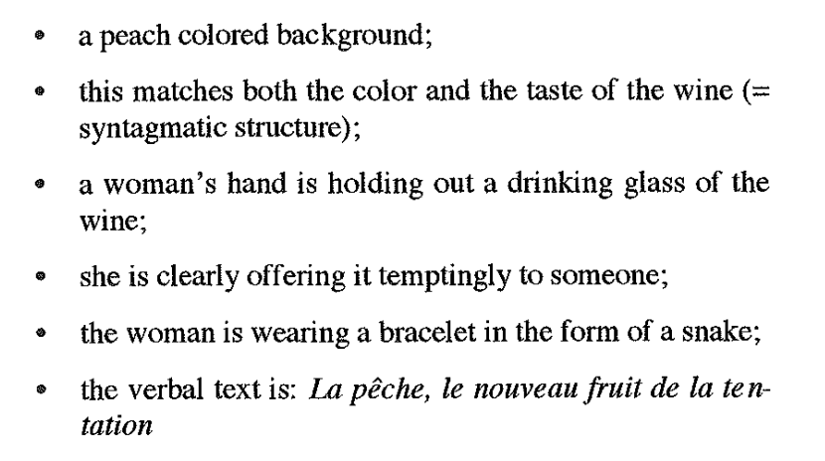
Main elements

Slide 6
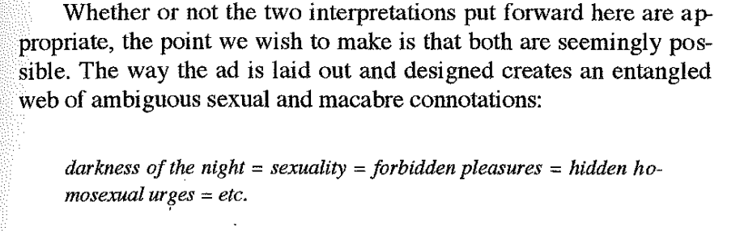
Connotative Chain

Slide 7
Connotative Chain
You can read into the ad, peach sexuality, ripe, positive
Or you can read into the ad macabre, poison, temptation, negative
Rorschach test for what most people will read into the ad
Oppositional reading will read against these common directions
Divorced or alcoholic, will read into this ad hate, money, pain
Drinks ads tease the best-case scenario

Slide 8
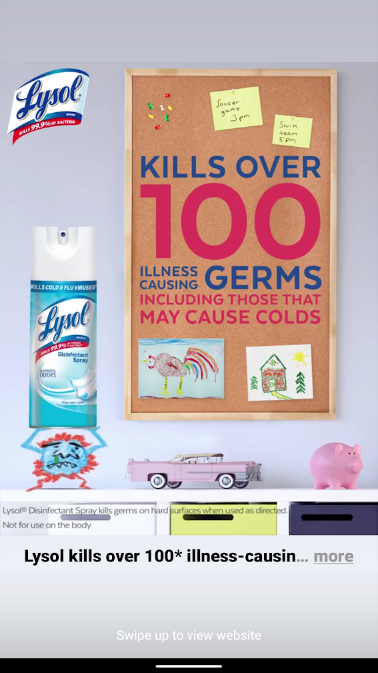

Slide 9
Connotative chains for Lysol
Planning board for children = parent is a good parent = taking care of their kid = keeping them safe from germs
Planning board = important activities = swim meet time = time to clean their room = as important as keeping them clean from germs = germ drawing by a kid = kids make germs = parents keep germs from kids with Lysol
Not an exact science, different people will make different connections

Slide 10
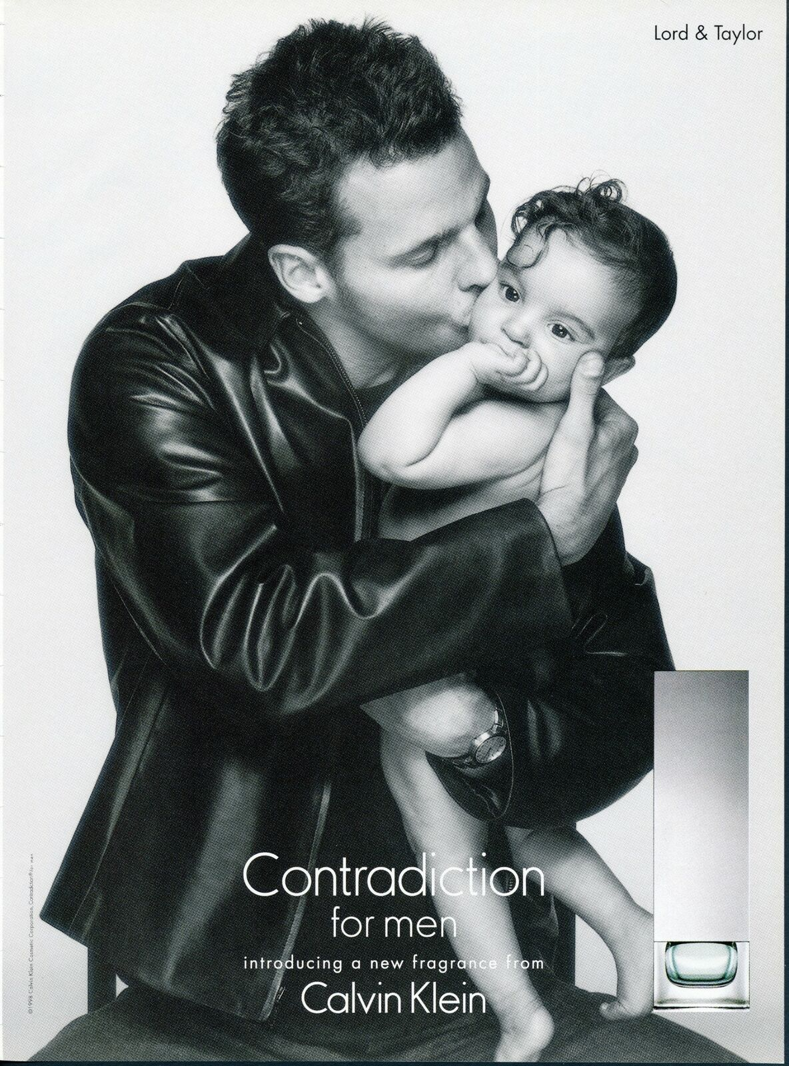

Slide 11
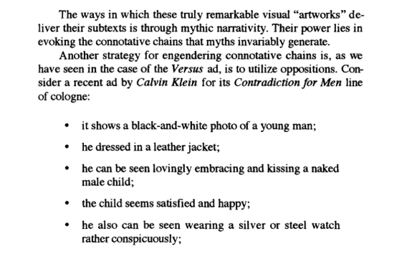

Slide 12
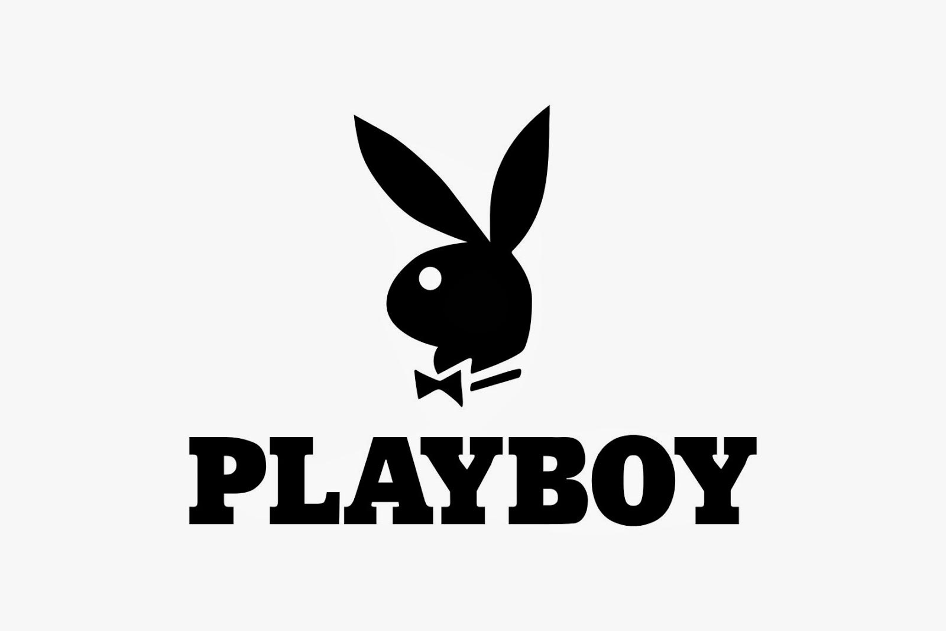

Slide 13
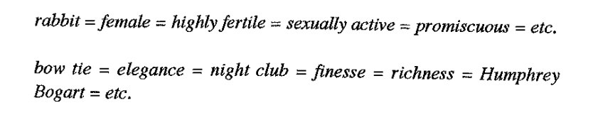
Chains of connotations (Playboy rabbit)

Slide 14
Blog posts
Examples use a lot of Greek mythology to analyze connotative chains
At each stage in the chain, you can brainstorm a lot of different meanings, pick one and keep going, then go back and take another branch, you will probably end up in different end points

Slide 15
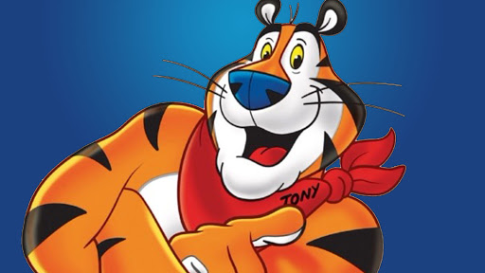

Slide 16
Activity
Connotative chain
Pick an advertisement and create a connotative chain with imagery that relates to parts of the ad
How do these connotations show up in advertisements using this logo
Tony the Tiger = Strong, Fun, Child friendly, Enthusiastic
Bandana = Human like = Not scary = Trusting
Physique = Works out a lot = Naked = Sexuality = Furry Culture

