Slide 1
Comm 2302
2-19-2020

Slide 2
Sex sells
Get your man concept
Mistress to wife
Putting the convertible in the showroom to entice but then selling the sedan, convertible for mistress, sedan for wife
Maidenform bra ads

Slide 3
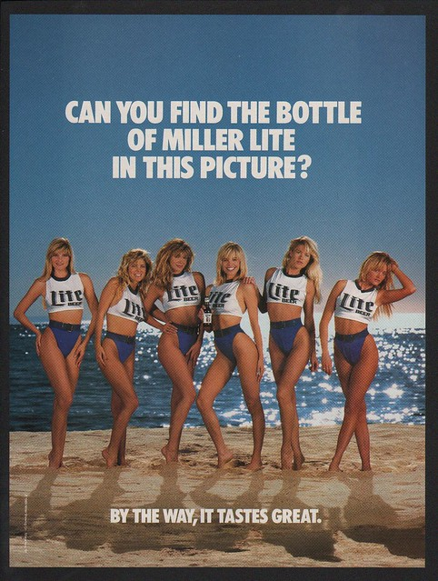

Slide 4
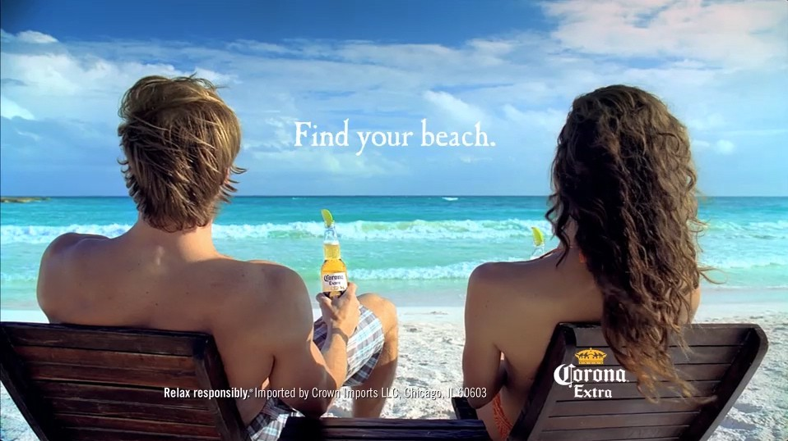

Slide 5
Examples in beer ads
Basest sexuality, showing a sexy female = beer, good beer, leaning into the sexism, our beer is so great it doesn’t matter how sexist this ad is
Tacit sexuality, showing moderately attractive men and women
Also in a sexual location, at a beach resort
Not where beer is actually drank, in a dive bar, couch, or parking lot
Wish fulfillment for alcohol, in ads for drinks, only best possible outcome is shown

Slide 6
Manly soap scents
Old spice names, Swagger, Captain, Bear glove, Krakengard, steel courage
Shaving soap

Slide 7
Psychology of oral fixation
First stage of psychosexual development for infant from birth to 18 months, one of Freud stages
The mouth is the primary erogenous zone, eating, sucking
Infant who is neglected during this time, over or under fed, will develop an oral fixation later in life
No evidence found that breast feeding period leads to smoking

Slide 8
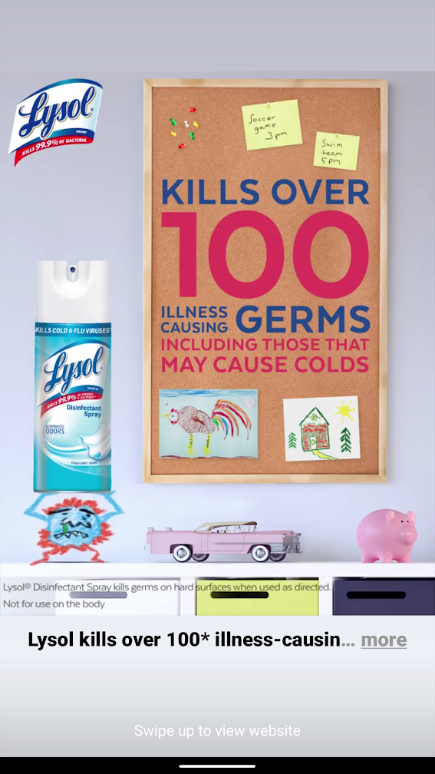

Slide 9


Slide 10
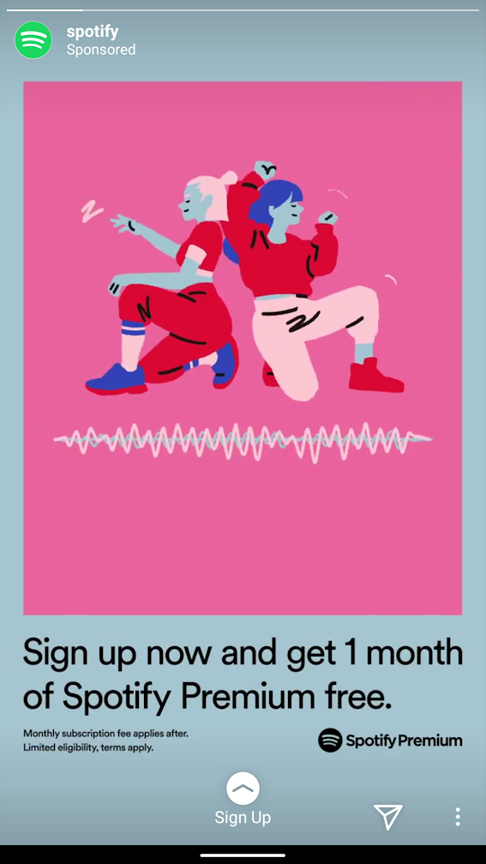

Slide 11
Notes in general about advertisement
Often the goal of the ad is not to sell you a product or service but just to remind of you of the brand, brand awareness
I’m aware of shiseido cosmetics but not a consumer
What assumptions do the ads make?
That I’m not a consumer of their products
Wealth background, purchasing decision making, male vs female
Also how to use the product, for what? Cleaning kids rooms
Black coffee means business

Slide 12
Blog posts
Products marketed over the top for only men or women
Hims ads or Erectile disfunction ads in general
Shavers priced differently to men and women
Pink tax on products like power tools
Also deodorants marketed towards men and women

Slide 13
Find an advertisement
Look through your social media feed and make a note of an advertisement
What is the ad for, a product, a service?
What is the psychology behind the ad? What wish does it fulfill?

