Slide 1
Comm 2302
1/31/2020

Slide 2
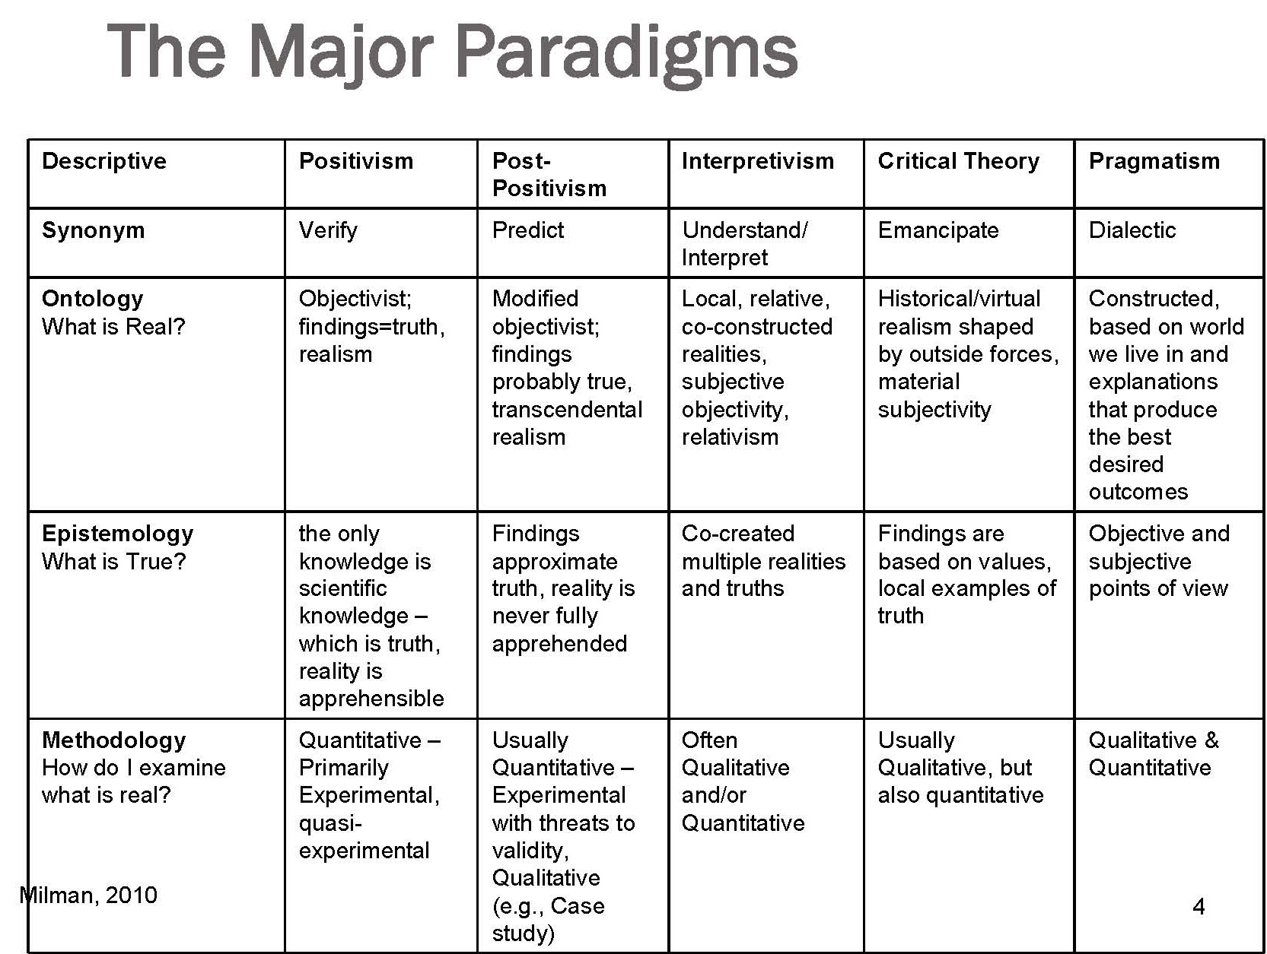
Post Modern
Deconstruction
Nothing is real only context of symbols. Semantics
Nothing exists outside of the text
Question presuppositions, values, ideologies,

Slide 3
History of Quant and Qual research in Comm
Quantitative view to make communication research scientific with a post-positivist world view
Qual counterpoint, to bring in interdisciplinary research from literature, psychology, political science, sociology to understand communication phenomena
Socially constructed example, jug of water, class blog, memes
A give and take from multiple people over time change meanings

Slide 4
Semiotics
Signs are drawings, photographs, paintings, words, acts, sounds, objects and gestures.
A sign is anything that represents or stands for something else.
R O S E, letters, rose emoji
Signifier word rose
Signified fragrant flower
Other meanings, the bachelor, DSA Democratic Socialists of America

Slide 5
Textual Analysis
Black Friday example
Quant study would look at articles about Black Friday
Coded positive, negative, or neutral depiction
Qual study, detective for relationships, wiki codes
Historical context, marketing or media slogan, themes from newspaper articles, relationship between images and article, placement of stories, how sources are used

Slide 6
Blog Posts
How meaning is made, slang terms online, acronyms for teens, urban dictionary
How meanings change over time, songs that were anti-war now put into pop playlists
Politicians asked not to use certain songs because their creators disagree with their politics

Slide 7
Activity
Show and tell CA
Pick one code from Monday or Wednesday, show through a search which posts fall under that code and why/why not

