Slide 1
Comm 2302
1/27/2020

Slide 2
Content Analysis Project
In pairs, coding a TV show for violence
Possible code book
Finding patterns
Changing codes

Slide 3
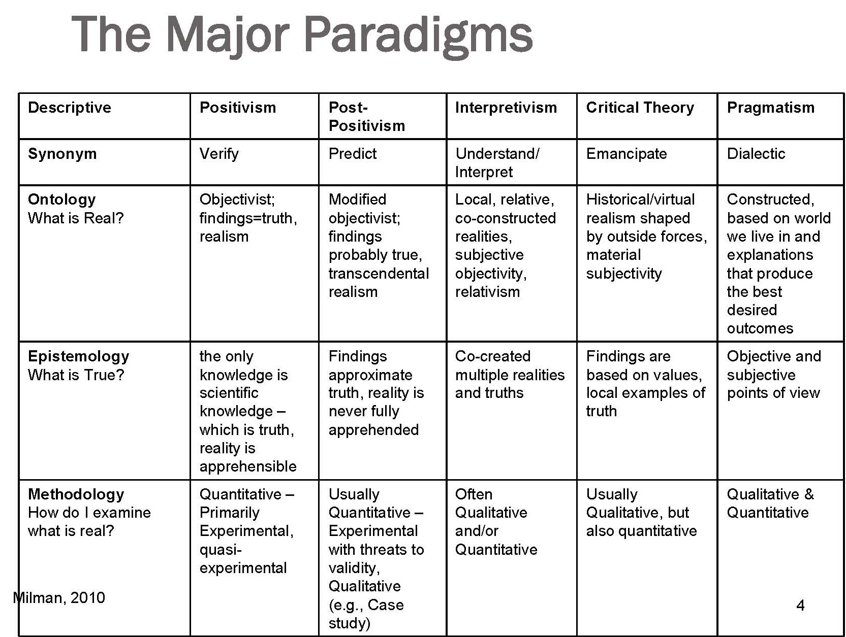
Post Modern
Deconstruction
Nothing is real only context of symbols. Semantics
Nothing exists outside of the text
Question presuppositions, values, ideologies,

Slide 4
Sparks Analyzing Media Content
Content Analysis allows a researcher to describe the nature of the comm content in a systematic and rigorous fashion.
Marge watching itchy and scratchy
Content Analysis is objective, systematic, and quantitative
Can be carried out by multiple researchers

Slide 5
Types of Content
Manifest content: actions that appear and require a
minimum of interpretation, amount of blood, gun shots
Latent content: meaning that must be interpreted and might have multiple interpretations, ex sarcasm?

Slide 6
Elements of CA
The Sample, what episodes are picked, from what larger sample, why
Unit of Analysis, for TV is it a scene? For an article, a paragraph?
Categories, a category scheme devised before coding is done, usually has a definition of a category with examples that fit
Coding Agreement, multiple coders used, only codes that were found by multiple people are agreed upon, less interpretation, repeatability

Slide 7
Blog Posts
Example of CA with Twitter
How to create high level and sub codes
How they can change, why do multiple passes

Slide 8
Activity
In pairs, pull up a social media feed, Twitter, IG, FB
Start thinking of high-level codes that are common in the feed, what are they, which posts fit?
Start a count, which are the most popular codes?

