Slide 1
Comm 2302
1/15/20

Slide 2
Syllabus & TLEARN
Go through when large assignments are due, where and when
Blog post due on Sunday by midnight
During class: short lecture, present blog posts for your day, activity

Slide 3
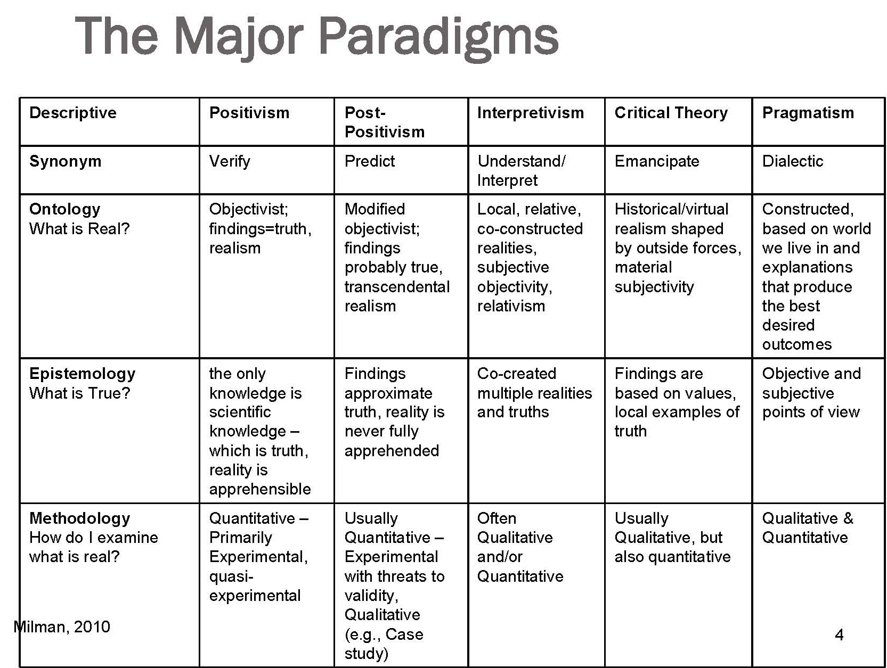
Post Modern
Deconstruction
Nothing is real only context of symbols. Semantics
Nothing exists outside of the text
Question presuppositions, values, ideologies,

Slide 4
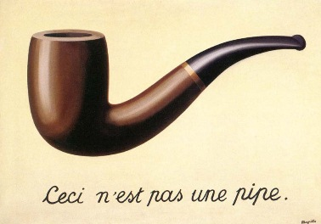
The Treachery of Images (This is not a pipe)

Slide 5
Post Modern (Far right paradigm)
Postmodernism is typically defined by an attitude of skepticism or distrust toward grand narratives, ideologies, and various tenets of Enlightenment rationality, including the existence of objective reality and absolute truth, as well as notions of rationality, human nature, and progress.
Architecture

Slide 6
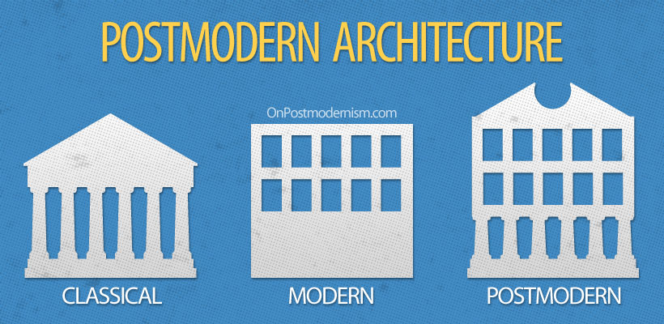

Slide 7
Media Studies
Media studies is a discipline and field of study that deals with the content, history, and effects of various media; in particular, the mass media. Media studies may draw on communication studies.
Researchers may also develop and employ theories and methods from disciplines including cultural studies, rhetoric (including digital rhetoric), philosophy, literary theory, psychology, political science, political economy, economics, sociology, anthropology, social theory, art history and criticism, film theory, feminist theory, and information theory. (Wikipedia)

Slide 8
Media studies
[TEXT] [THEORY] [RESEARCH]
Book feminism little women
Twitter power dynamics black twitter
Reality TV political economy undercover boss
Fan blogs slash fic gender constructs
WNBA tweets sexism sexist attitudes
  → [READING] → →[PATTERNS]→

Slide 9
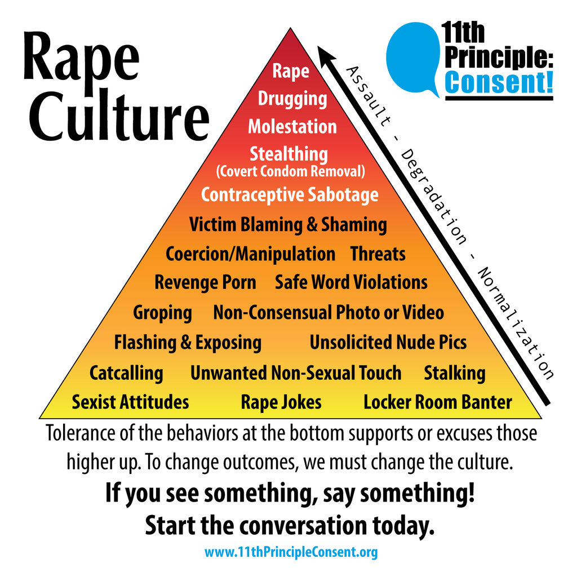

Slide 10
Tips
Green text writing (also turn off spell/grammar check for drafts)
Posture while reading, standing, walking
APA formatting, use google scholar

Slide 11
WordPress signup
Signup for WordPress
Make sure you are added to our blog
Only post your submissions to our blog
Make sure you are an author to our blog

Slide 12
Activity
Cluster diagrams
TV shows, Youtube series/channels, twitch etc
Social media follows, who and where, comedians on IG, snap, etc

